Slide 1
Early Atomic Theory and Structure
Chapter 5

Slide 2
What are the building blocks of matter?
Early Greeks
Air, Earth, Water, Fire
Democritus (470-370 BC)
Atoms
John Dalton (1766-1844)
Modern Atomic Theory

Slide 3
Dalton’s Atomic Theory
Elements (matter) is composed of small, indivisible particles called atoms.
Atoms of a given element are identical in mass and behavior.
Atoms of different elements differ in mass and behavior.
Chemical combination of elements to make different substances occurs when atoms join together in small whole number ratios.
Chemical reactions only rearrange the way the atoms are combined; the atoms themselves are not changed.

Slide 5
Law of Constant Composition
The composition of a substance is always the same, regardless of how the substance was made or where the substance is found.
Law of Multiple Proportions
Atoms of two or more elements may combine in different ratios to form different compounds.
Saw these in Chapter 3-
Both explained by Dalton’s Atomic Theory.

Slide 6
Sub Atomic Particles

Slide 7
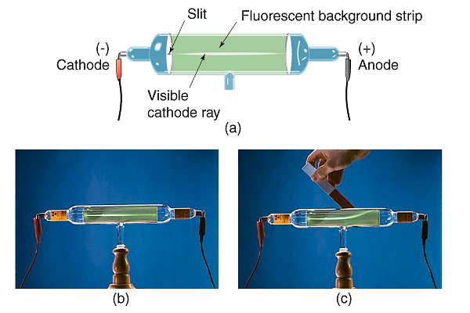

Slide 8
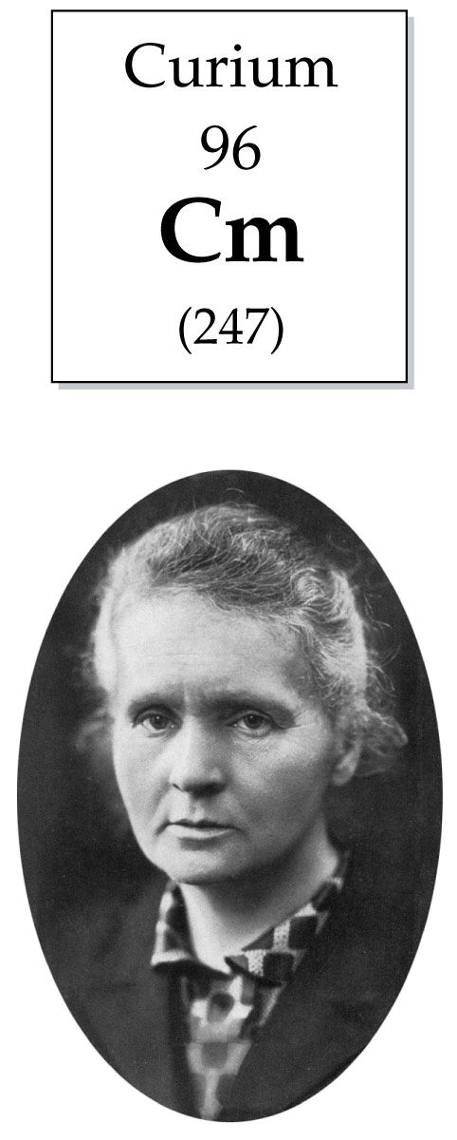

Slide 9
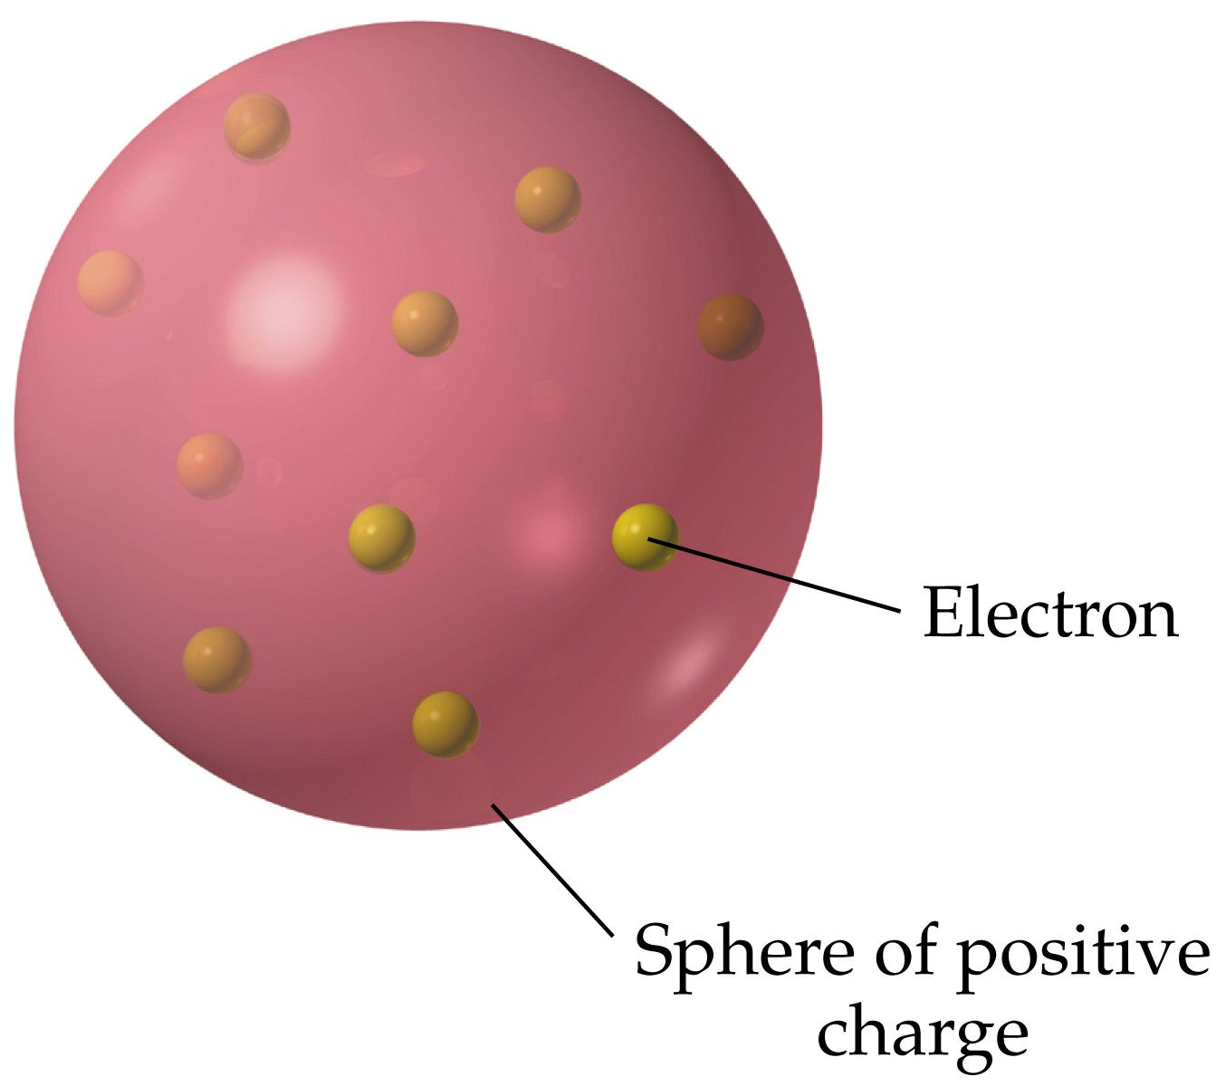

Slide 10
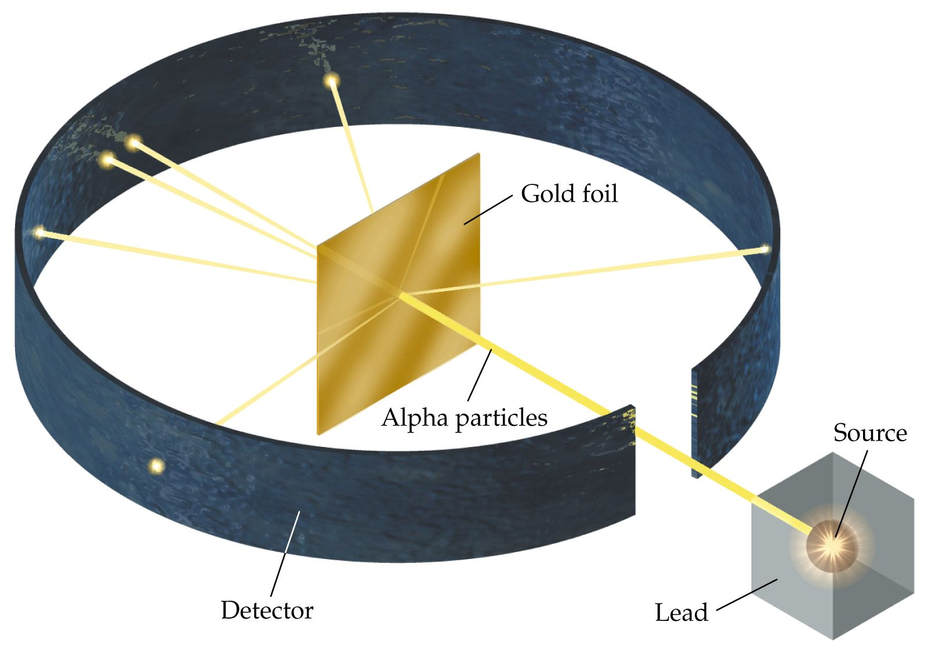

Slide 11
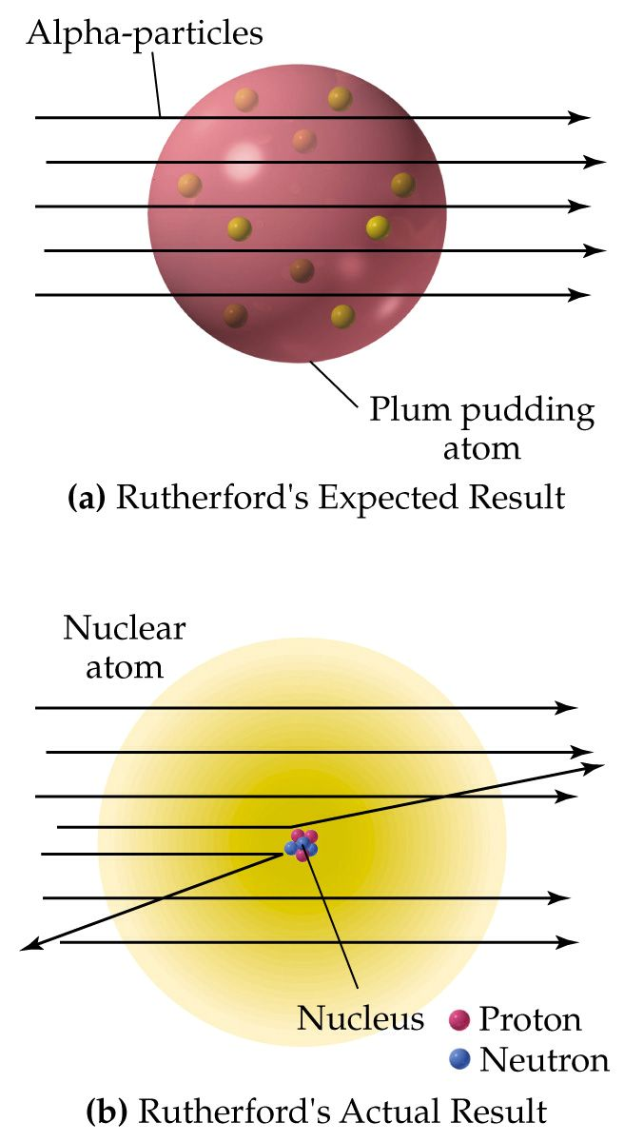

Slide 12
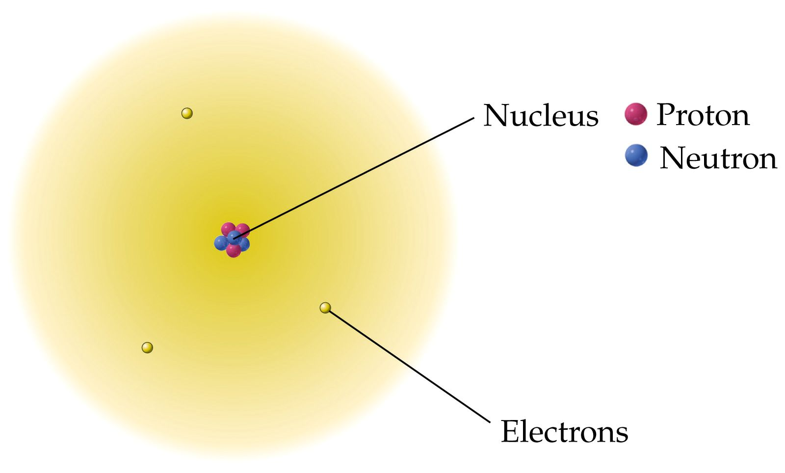

Slide 13
Atoms are composed of

Slide 14
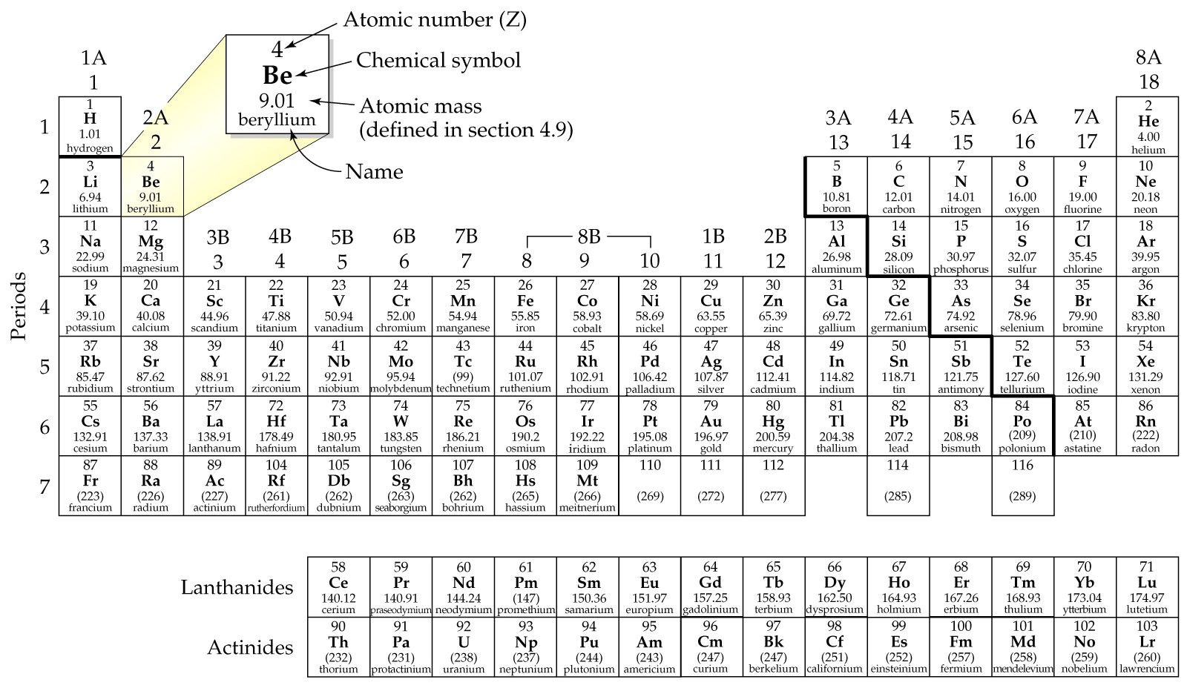

Slide 15
Isotopes
Atoms which differ only in the number of neutrons present in the nucleus.
Neutrons help keep the protons together by adding to the strong nuclear force without adding to the mutually repulsive electrical force of the protons.
Generally 1-1.5 neutrons per proton in an atom’s nucleus.

Slide 16
¹H | ²H | ³H

Slide 17
Atomic Number = Z = number of protons in an atom. = number of electrons in a neutral atom. Mass Number = number protons + number neutrons in an atom

Slide 18
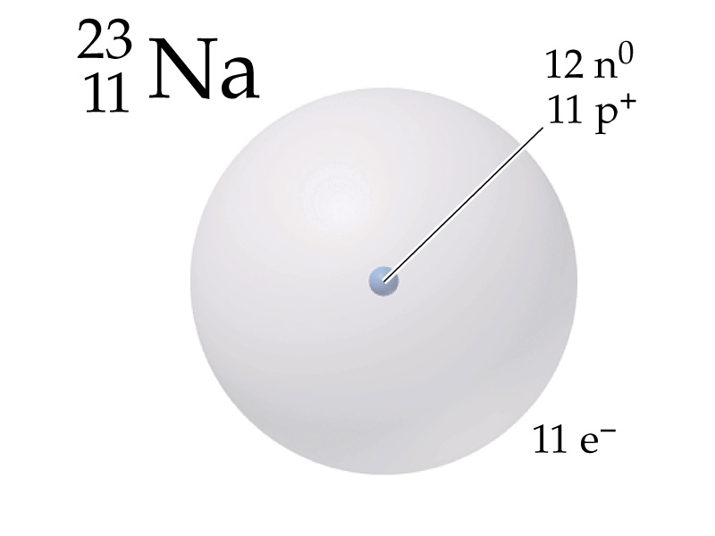
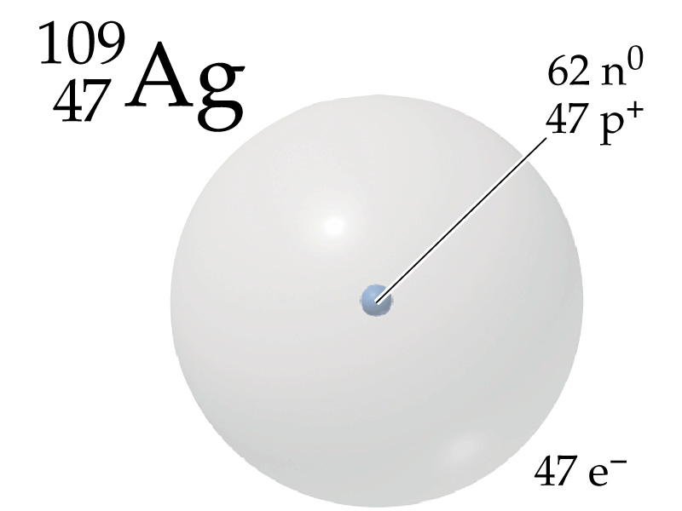

Slide 19
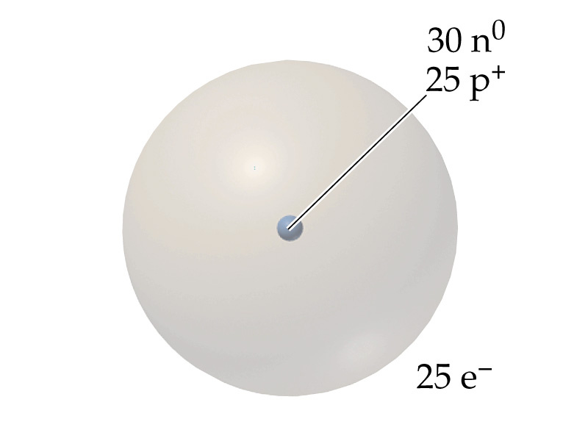

Slide 20
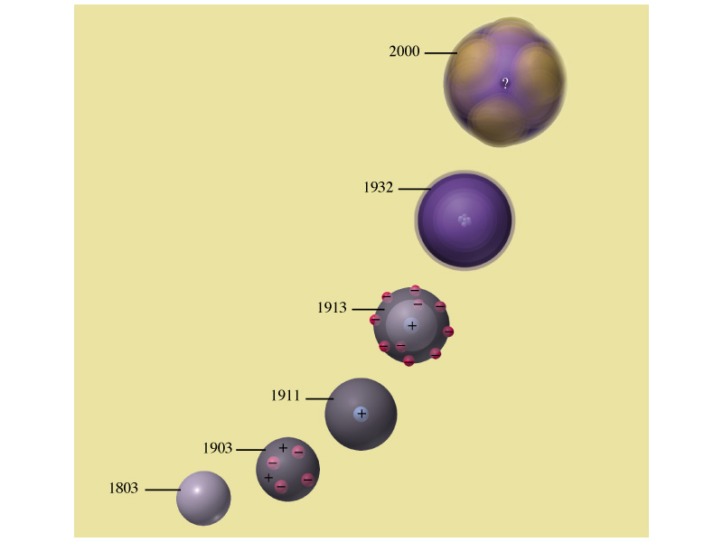

Slide 21
Atomic Mass
The average relative mass of the isotopes of an element compared to the atomic mass of carbon-12 (exactly 12 amu)
Atomic mass unit (amu)
1/12 the mass of a carbon-12 atom
1.6606 x 10⁻²⁴ g

Slide 22
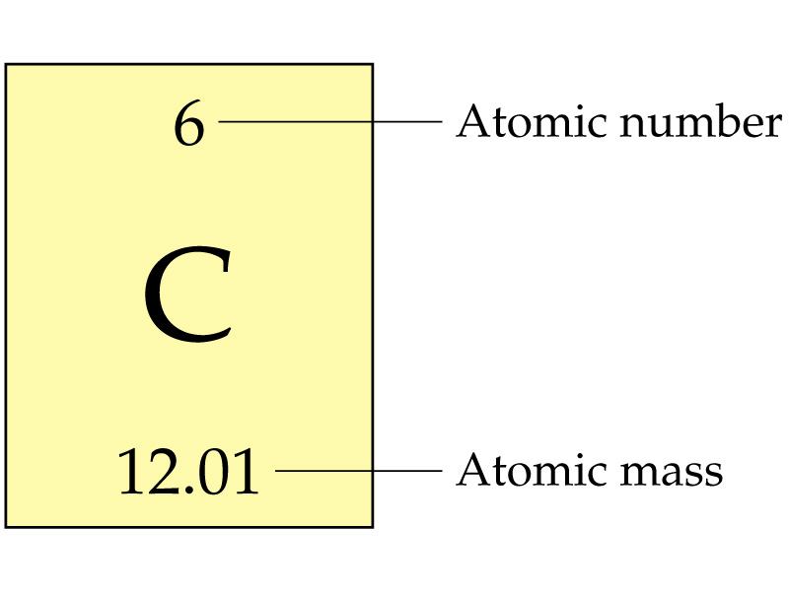
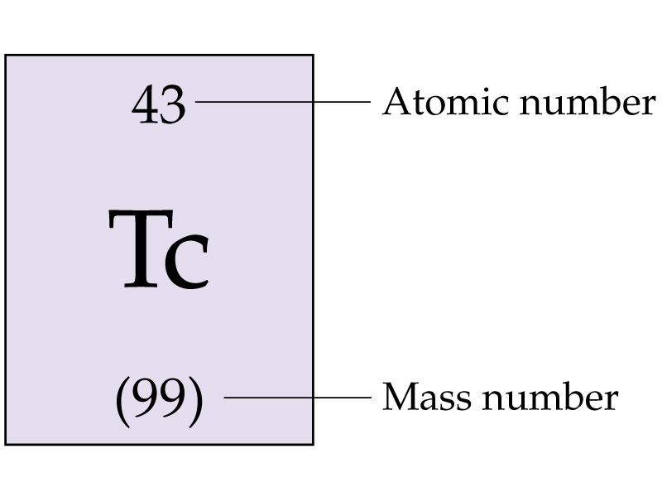

Slide 23
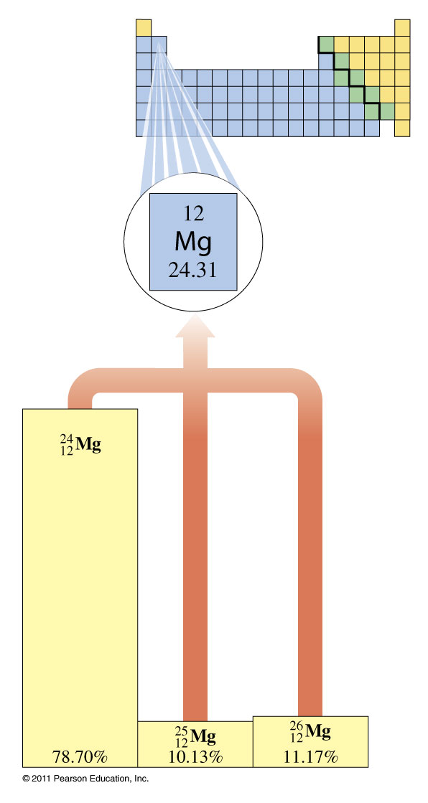
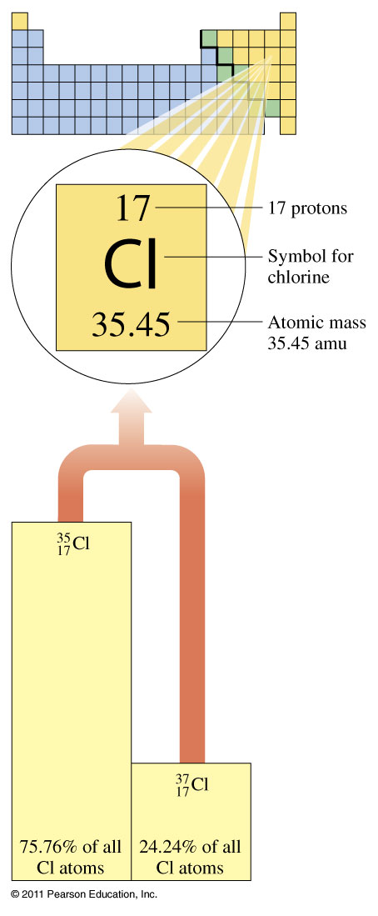

Slide 24
Isotopes of Neon

Slide 25
Isotopes of Neon

